Slide 1


CORE COMPONENT
https://reactnative.dev/docs/components-and-apis
NGUYEN TRONG TIEN
Notes:
https://reactnative.dev/docs/components-and-apis
https://reactnative.dev/docs/components-and-apis#basic-components
https://reactnative.dev/docs/accessibilityinfo

Slide 2
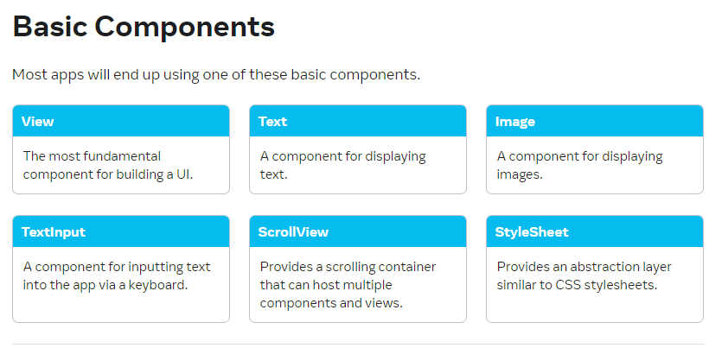
https://reactnative.dev/docs/components-and-apis
Notes:
https://reactnative.dev/docs/accessibilityinfo

Slide 3
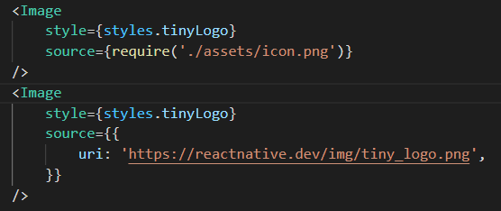
Image

Slide 4
ImageBackground

Slide 5
Pressable

Slide 6
SafeAreaView

Slide 7
TextInput

Slide 8
TouchableOpacity

Slide 9
TouchableHighlight

Slide 10
FlatList

Slide 11
SectionList

Slide 12
Modal

Slide 13
KeyboardAvoidingView

Slide 14
RefreshControl

Slide 15
ScrollView

Slide 16
Switch

Slide 17
TouchableWithoutFeedback

Slide 18
THANK YOU!

